Slide 2
SQL DW Gen2: New Features & Enhancements
Kal Yella

Slide 3
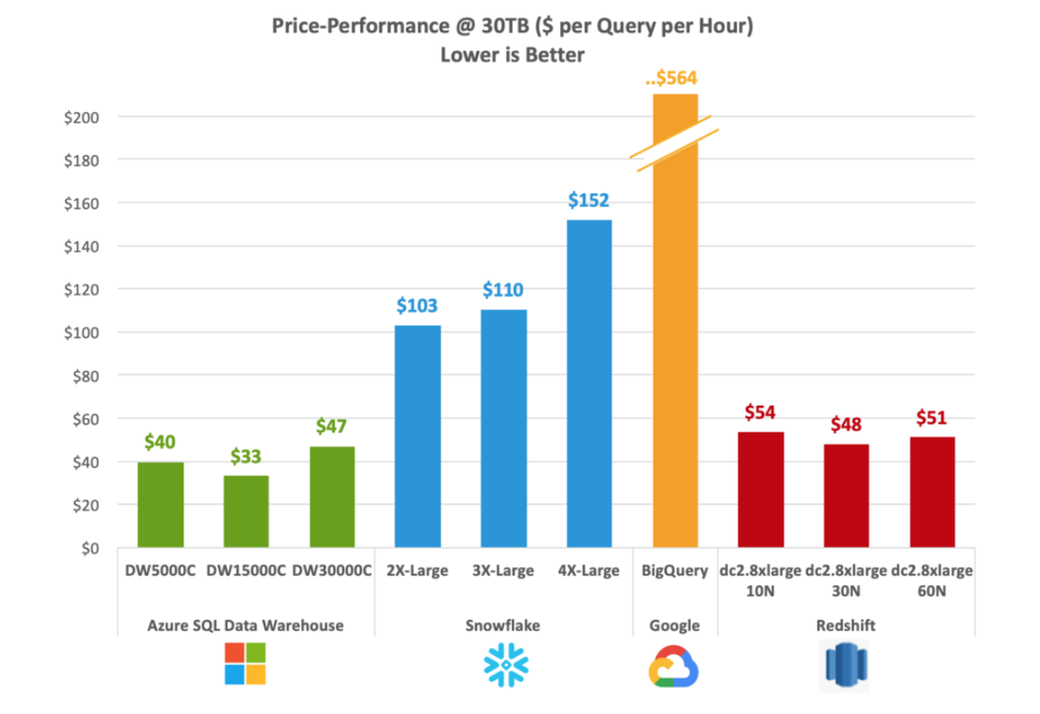
Best-in-class price per performance
Performance
Price-performance is calculated by GigaOm as the TPC-H metric of cost of ownership divided by composite query.
Results based on GigaOm’s TPC-H results, published in January 2019

Slide 4
Agenda
Adaptive cache internals
Instant data movement on Gen2
Resource classes on Gen2
Workload Management
Security Enhancements
What’s New since Gen2

Slide 5
Adaptive cache

Slide 6
Gen2 Architecture bottomless storage
Control
Cores
Memory
SSD TempDB
Cores
Memory
Cores
Memory
Cores
Memory
NVMe SSD
NVMe SSD
NVMe SSD
Compute
Cache
TempDB
Cache
TempDB
Cache
TempDB
Data
Remote storage
Snapshot backups
Log
Notes:
Non-Volatile Memory / Flash Memory hosting Cache and tempdb
NVM Express reduces I/O overhead and brings various performance improvements in comparison to previous logical-device interfaces, including multiple, long command queues, and reduced latency.

Slide 7
Automated Tiering Of Storage Layers
Node
Capacity
Access
Time
Memory
Adaptive Cache
Remote Storage
hot data
300GB+
70 ns
1.5TB
warm data
20 µs
∞
100 ms
cold data

Slide 8
Adaptive cache miss (cold scan)
SELECT SUM(TotalCost)
FROM FactSales_CCI
Adaptive cache hit (hot scan)
SELECT SUM(TotalCost)
FROM FactSales_CCI
Columnstore Object Pool
Memory
Hit?
Adaptive
Cache
Local NVMe SSD
Hit?
Remote storage
Remote Read
Notes:
Non-Volatile Memory / Flash Memory hosting Cache and tempdb
NVM Express reduces I/O overhead and brings various performance improvements in comparison to previous logical-device interfaces, including multiple, long command queues, and reduced latency.

Slide 9
Clearing the adaptive cache
DBCC DROPCLEANBUFFERS (ALL)
Pause or Scale
Columnstore Object Pool
Memory
Update costing info
Adaptive
Cache
Local NVMe SSD
Remote storage
Notes:
Non-Volatile Memory / Flash Memory hosting Cache and tempdb
NVM Express reduces I/O overhead and brings various performance improvements in comparison to previous logical-device interfaces, including multiple, long command queues, and reduced latency.

Slide 10
Adaptive cache miss (full cache, cold scan)
SELECT SUM(TotalCost)
FROM FactSales_CCI
SELECT SUM(TotalCost)
FROM FactSales_CCI
Columnstore Object Pool
Memory
Hit?
Full Adaptive
Cache
Local NVMe SSD
Hit?
Remote storage
Remote Read
Notes:
Non-Volatile Memory / Flash Memory hosting Cache and tempdb
NVM Express reduces I/O overhead and brings various performance improvements in comparison to previous logical-device interfaces, including multiple, long command queues, and reduced latency.
Go into the algorithm – oldest accessed segment

Slide 11
Sizing the Gen2 Cache
Working set ~20%
1.5TB Gen2 cache per DWU 500
EXEC sp_spaceused
Same TempDB on both Gen1 and Gen2
This cache is per node
DWU | Memory (GB) | Tempdb (TB) | Gen2 Cache (TB)
1000 | 720 | 4 | 3
1500 | 1080 | 5 | 4.5
2000 | 1440 | 7 | 6
2500 | 1800 | 9 | 7.5
3000 | 2160 | 11 | 9
5000 | 3600 | 18 | 15
6000 | 4320 | 22 | 18
7500 | 5400 | 27 | 22.5
10000 | 7200 | 36 | 30
15000 | 10800 | 54 | 45
30000 | 21600 | 108 | 90

Slide 12
CREATE TABLE #gen2Table_HEAP
WITH
(
HEAP,
DISTRIBUTION = ROUND_ROBIN
)
AS SELECT * FROM externalGen2Table;
SELECT SUM(TotalCost)
FROM gen2TableCCI
SELECT SUM(TotalCost)
FROM gen2TableHeap
CREATE TABLE gen2TableCCI
WITH
(
CLUSTERED COLUMNSTORE INDEX,
DISTRIBUTION = ROUND_ROBIN
)
AS SELECT * FROM externalGen2Table;
Loading into Gen2
CREATE TABLE gen2TableHeap
WITH
(
HEAP,
DISTRIBUTION = ROUND_ROBIN
)
AS SELECT * FROM externalGen2Table;
SELECT SUM(TotalCost)
FROM #gen2TableHeap
Columnstore Object Pool
Buffer
Pool
Memory
Gen2
Cache
Tempdb
Local NVMe SSD
Remote storage
External storage
ExternalFiles
Notes:
Non-Volatile Memory / Flash Memory hosting Cache and tempdb
NVM Express reduces I/O overhead and brings various performance improvements in comparison to previous logical-device interfaces, including multiple, long command queues, and reduced latency.
tempdb (running out of tempdb so up in size) visuals

Slide 13
Gen2 Performance Accelerator

Slide 14
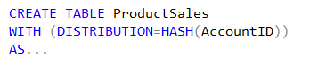
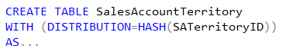
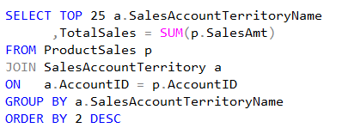
Distributed Data Movement
ProductSales
SalesAccountTerritory
AccountID | SalesAmt | …
47 | $1,234.36 | …
36 | $2,345.47 | …
14 | $3,456.58 | …
25 | $4,567.69 | …
48 | $5,678.70 | …
37 | $6,789.81 | …
… | … | …
SATerritoryID | AccountID | …
444 | 37 | …
333 | 25
111 | 36 | …
222 | 47 | …
445 | 14
334 | 48 | …
… | … | …
Node 1:
Node 2:
Node 3:
Node 4:
Node 5:
Node 6:
Shuffle
SATName | TotalSales
North | $6,789.81
South | $5,678.70
NorthEast | $4,567.69
SouthWest | $3,456.58
East | $2,345.47
West | $1,234.36
AccountID | SATName | …
47 | West | …
36 | East
14 | SouthWest | …
25 | NorthEast | …
48 | South
37 | North | …
… | … | …

Slide 15
Gen1 – Data Movement Service
SQL DW Compute Node 2
SQL Engine
Distributed Tables
TEMP DB
SQL DW Compute Node 1
SQL Engine
Data Movement Service
Distributed Tables
TEMP DB
SQL DW Compute Node 3
Data Movement Service
SQL Engine
Distributed Tables
TEMP DB
Stand-alone process, fixed memory
Single-threaded read – BulkCopy API
Copy is not scalable (cores and network)
Data Movement Service

Slide 16
Gen2 – instant data movement
SQL DW Compute Node 2
SQL Engine
Distributed Tables
SQL DW Compute Node 1
TEMP DB
SQL Engine
Distributed Tables
TEMP DB
SQL DW Compute Node 3
SQL Engine
Distributed Tables
Data does not leave SQL Engine
Batch-mode: minimal overhead
Scalable: leverages all cores and network
TEMP DB

Slide 17
Lower Entry Point
Gen1
Gen2
Gen2-L.E.
Cores
Memory
Cores
Memory
NVMe SSD
NVMe SSD
Cache
Tempdb
Cache
Tempdb
DW1000c – DW30000c
Cores
Memory
NVMe SSD
Cache
Tempdb
DW100c – DW500c
Cores
Memory
SSD Tempdb
DW100 - DW6000
Notes:
6 cores, 42 GB ram per node
36 cores, 360 GB ram

Slide 18
Gen2 Resource Classes

Slide 19
History of Dynamic Resource Classes
On Gen1, SmallRc is really a static resource class
As the instance is scaled, more queries can run
The performance remains constant
Desired default behavior, as instance scales, queries run faster
Notes:
Not ideal for default behavior.

Slide 20
Gen1 - Inconsistent Concurrency
As services levels change, concurrency fluctuates
Scaling from DW1500 to DW2000 reduces concurrency from 4 to 3
Gen1 Concurrency Slot Options
1
2
4
8
16
32
64
128
Notes:
Gen1 has fixed resource pools that memory grants and concurrency use

Slide 21
Gen2 – Simpler resource model
With Gen2, dynamic resource pools were introduced with a 3-10-22-70 model for resource allocations.
Instead of choosing from 8 resource pools, they are calculated on the fly per service level.
Resource Class | Percent Resources
SmallRc | 3%
MediumRc | 10%
LargeRc | 22%
XLargeRc | 70%
Resource Class | Percent Resources | Concurrency
SmallRc | 3% | 32
MediumRc | 10% | 10
LargeRc | 22% | 4
XLargeRc | 70% | 1

Slide 22
Gen2 – Simpler model
At MediumRc, an example…
MediumRC |  | Gen1 Model |  | Gen2 Model
Service Level | Total Slots | Slots | Concurrency | Slots | Concurrency
DW1000c | 40 | 8 | 5 | 4 | 10
DW1500c | 60 | 8 | 7 | 6 | 10
DW2000c | 80 | 16 | 5 | 8 | 10
DW2500c | 100 | 16 | 6 | 10 | 10
DW3000c | 120 | 16 | 7 | 12 | 10
DW5000c | 200 | 32 | 6 | 20 | 10
DW6000c | 240 | 32 | 7 | 24 | 10
DW7500c | 300 | 64 | 4 | 30 | 10
DW10000c | 400 | 64 | 6 | 40 | 10
DW15000c | 600 | 64 | 9 | 60 | 10
DW30000c | 1200 | 64 | 18 | 120 | 10

Slide 23
What’s new since Gen2
Notes:
GA was May 1, 2018
https://azure.microsoft.com/en-us/updates/elevate-your-performance-with-azure-sql-data-warehouse-gen2/

Slide 24
Workload Management

Slide 25




WORKLOAD IMPORTANCE – no importance
Scheduler without importance
Overview
CEO
CEO
CEO
Workload importance allows you to prioritize the queries that get access to resources. It helps ensure that high-business value work is executed first on a busy data warehouse.
1
2
3
9
4
5
10
6
7
8
10
9
11
12
10
11
12
Running
Queued
Queued
Queued
Notes:
Talking Points:
Use the ALTER DATABASE statement to enable the query store.
ALTER DATABASE Databasename SET QUERY_STORE = ON;
Query Store catalog views:
sys.database_query_store_options (Transact-SQL)
sys.query_context_settings (Transact-SQL)
sys.query_store_plan (Transact-SQL)
sys.query_store_query (Transact-SQL)
sys.query_store_query_text (Transact-SQL)
sys.query_store_runtime_stats (Transact-SQL)
sys.query_store_runtime_stats_interval (Transact-SQL)
Query Store stored procedures:
sp_query_store_flush_db (Transact-SQL)
sp_query_store_force_plan (Transact-SQL)
sp_query_store_remove_plan (Transct-SQL)
sp_query_store_remove_query (Transact-SQL)
sp_query_store_reset_exec_stats (Transact-SQL)
sp_query_store_unforce_plan (Transact-SQL)

Slide 26
WORKLOAD CLASSIFICATION
Overview
CREATE WORKLOAD CLASSIFIER classifier_name
WITH
(
[WORKLOAD_GROUP = '<Resource Class>' ]
[IMPORTANCE = { LOW |
BELOW_NORMAL |
NORMAL |
ABOVE_NORMAL |
HIGH
}
]
[MEMBERNAME = ‘security_account’]
)
Allows you to map a query to an allocation of resources via pre-determined rules
Use this in combination with workload importance to effectively share resources across different workload types
Notes:
Talking Points:
Use the ALTER DATABASE statement to enable the query store.
ALTER DATABASE Databasename SET QUERY_STORE = ON;
Query Store catalog views:
sys.database_query_store_options (Transact-SQL)
sys.query_context_settings (Transact-SQL)
sys.query_store_plan (Transact-SQL)
sys.query_store_query (Transact-SQL)
sys.query_store_query_text (Transact-SQL)
sys.query_store_runtime_stats (Transact-SQL)
sys.query_store_runtime_stats_interval (Transact-SQL)
Query Store stored procedures:
sp_query_store_flush_db (Transact-SQL)
sp_query_store_force_plan (Transact-SQL)
sp_query_store_remove_plan (Transct-SQL)
sp_query_store_remove_query (Transact-SQL)
sp_query_store_reset_exec_stats (Transact-SQL)
sp_query_store_unforce_plan (Transact-SQL)

Slide 27

WORKLOAD IMPORTANCE –importance
Scheduler with Importance
Overview
CEO
CEO
Workload importance allows you to prioritize the queries that get access to resources. It helps ensure that high-business value work is executed first on a busy data warehouse.
1
2
3
12
4
5
6
7
8
9
10
11
12
Normal
Low
Normal
High
Running
Queued
Queued
Notes:
Talking Points:
Use the ALTER DATABASE statement to enable the query store.
ALTER DATABASE Databasename SET QUERY_STORE = ON;
Query Store catalog views:
sys.database_query_store_options (Transact-SQL)
sys.query_context_settings (Transact-SQL)
sys.query_store_plan (Transact-SQL)
sys.query_store_query (Transact-SQL)
sys.query_store_query_text (Transact-SQL)
sys.query_store_runtime_stats (Transact-SQL)
sys.query_store_runtime_stats_interval (Transact-SQL)
Query Store stored procedures:
sp_query_store_flush_db (Transact-SQL)
sp_query_store_force_plan (Transact-SQL)
sp_query_store_remove_plan (Transct-SQL)
sp_query_store_remove_query (Transact-SQL)
sp_query_store_reset_exec_stats (Transact-SQL)
sp_query_store_unforce_plan (Transact-SQL)

Slide 28
WORKLOAD isolation (Preview)
Overview
CREATE WORKLOAD GROUP group_name
WITH
(
[ MIN_PERCENTAGE_RESOURCE = value ]
[ CAP_PERCENTAGE_RESOURCE = value ]
[ MAX_CONCURRENCY = value ]
)
Isolation allocates fixed resources to workloads within a data warehouse. These limits are strictly enforced for memory, and only enforced under load for CPU and IO.
Notes:
Talking Points:
Use the ALTER DATABASE statement to enable the query store.
ALTER DATABASE Databasename SET QUERY_STORE = ON;
Query Store catalog views:
sys.database_query_store_options (Transact-SQL)
sys.query_context_settings (Transact-SQL)
sys.query_store_plan (Transact-SQL)
sys.query_store_query (Transact-SQL)
sys.query_store_query_text (Transact-SQL)
sys.query_store_runtime_stats (Transact-SQL)
sys.query_store_runtime_stats_interval (Transact-SQL)
Query Store stored procedures:
sp_query_store_flush_db (Transact-SQL)
sp_query_store_force_plan (Transact-SQL)
sp_query_store_remove_plan (Transct-SQL)
sp_query_store_remove_query (Transact-SQL)
sp_query_store_reset_exec_stats (Transact-SQL)
sp_query_store_unforce_plan (Transact-SQL)

Slide 29
Industry Leading Performance

Slide 30
Industry Leading Performance

Slide 31
Gen2 Performance Announcement Details
Gen2 GA
Turbocharge cloud analytics with Azure SQL Data Warehouse
Blazing fast data warehousing with Azure SQL Data Warehouse
Adaptive Caching
Adaptive caching powers Azure SQL Data Warehouse performance gains
Instant data movement
Lightning fast query performance with Azure SQL Data Warehouse
GigaOm Benchmarking Report
https://gigaom.com/report/data-warehouse-in-the-cloud-benchmark/

Slide 32
Gen2 Future Goodies
Region parity – capacity expansion
Instant data movement vNext
Cache Optimizations
Intelligence on what to cache
Faster eviction
Cache on load
Pre-cache on scale – pause/resume

Slide 33
Security Enhancements

Slide 34
Row-level security (RLS)
Overview
Fine grained access control of specific rows in a database table
Help prevent unauthorized access when multiple users share the same tables
Eliminates need to implement connection filtering in multitenant applications
Administer via SQL Server Management Studio or SQL Server Data Tools
Easily locate enforcement logic inside the database and schema bound to the table
Customer 1
Customer 2
Customer 3
SQL Data Warehouse
Notes:
Objective: Row-Level Security (RLS) simplifies the design and coding of security in your application.
Talking Points:
RLS enables you to implement restrictions on data row access. For example, ensuring that workers can access only those data rows that are pertinent to their department, or restricting a customer's data access to only the data relevant to their company.
The access restriction logic is located in the database tier rather than away from the data in another application tier. The database system applies the access restrictions every time that data access is attempted from any tier. This makes your security system more reliable and robust by reducing the surface area of your security system.
Implement RLS by using the CREATE SECURITY POLICY Transact-SQL statement, and predicates created as inline table valued functions.
Source: https://docs.microsoft.com/en-us/sql/relational-databases/security/row-level-security?toc=%2Fazure%2Fsql-data-warehouse%2Ftoc.json&view=sql-server-2017

Slide 35
RLS - Create a security policy
Create a security policy for row-level security
The following examples demonstrate the use of the CREATE SECURITY POLICY syntax
-- The following syntax creates a security policy with a filter predicate for the Customer table
CREATE SECURITY POLICY [FederatedSecurityPolicy]
ADD FILTER PREDICATE [rls].[fn_securitypredicate]([CustomerId])
ON [dbo].[Customer];
-- Create a new schema and predicate function, which will use the application user ID stored in CONTEXT_INFO to filter rows.
CREATE FUNCTION rls.fn_securitypredicate (@AppUserId int)
RETURNS TABLE
WITH SCHEMABINDING
AS
RETURN (
SELECT 1 AS fn_securitypredicate_result
WHERE
DATABASE_PRINCIPAL_ID() = DATABASE_PRINCIPAL_ID('dbo') -- application context
AND CONTEXT_INFO() = CONVERT(VARBINARY(128), @AppUserId));
GO
Notes:
Objective: Row-level filtering of data selected from a table is enacted through a security predicate filter defined as an inline table valued function. The function is then invoked and enforced by a security policy. The policy can restrict the rows that may be viewed (a filter predicate), but does not restrict the rows that can be inserted or updated from a table (a blocking predicate). There is no indication to the application that rows have been filtered from the result set; if all rows are filtered, then a null set will be returned.
Talking Points:
Filter predicates are applied while reading data from the base table, and it affects all get operations: SELECT, DELETE (i.e. user cannot delete rows that are filtered), and UPDATE (i.e. user cannot update rows that are filtered, although it is possible to update rows in such way that they will be subsequently filtered). Blocking predicates are not available in this version of RLS, but equivalent functionality (i.e. user cannot INSERT or UPDATE rows such that they will subsequently be filtered) can be implemented using check constraints or triggers.
Filter predicates and security policies have the following behavior:
Define a security policy that filters the rows of a table. The application is unaware that any rows have been filtered for SELECT, UPDATE, and DELETE operations, including situations where all the rows have been filtered out. The application can INSERT any rows, regardless of whether or not they will be filtered during any other operation. Define a predicate function that joins with another table and/or invokes a function. The join/function is accessible from the query and works as expected without any additional permission checks.
Issue a query against a table that has a security predicate defined but disabled. Any rows that would have been filtered or restricted are not affected.
The dbo user, a member of the db_owner role, or the table owner queries against a table that has a security policy defined and enabled. Rows are filtered/restricted as defined by the security policy.
Attempts to alter the schema of a table bound by a security policy will result in an error. However, columns not referenced by the filter predicate can be altered.
Attempts to add a predicate on a table that already has one defined (regardless of whether it is enabled or disabled) results in an error.
Attempts to modify a function used as a predicate on a table within a security policy results in an error.
Defining multiple active security policies that contain non-overlapping predicates, succeeds.
Source: https://msdn.microsoft.com/en-us/library/azure/dn765131.aspx

Slide 36
RLS in three steps
1. Policy manager creates filter predicate and security policy in T-SQL, binding the predicate to the Patients table
2. App user (e.g., nurse) selects from Patients table
3. Security policy transparently rewrites query to apply filter predicate
Policy manager
Database
CREATE FUNCTION dbo.fn_securitypredicate(@wing int)
RETURNS TABLE WITH SCHEMABINDING AS
return SELECT 1 as [fn_securitypredicate_result] FROM
StaffDuties d INNER JOIN Employees e
ON (d.EmpId = e.EmpId)
WHERE e.UserSID = SUSER_SID() AND @wing = d.Wing;
CREATE SECURITY POLICY dbo.SecPol
ADD FILTER PREDICATE dbo.fn_securitypredicate(Wing) ON Patients
WITH (STATE = ON)
Security policy
Filter Predicate:
INNER JOIN…
Nurse
Patients
Application
SELECT * FROM Patients
SEMIJOIN APPLY dbo.fn_securitypredicate(patients.Wing);
SELECT * FROM Patients
SELECT Patients.* FROM Patients,
StaffDuties d INNER JOIN Employees e ON (d.EmpId = e.EmpId)
WHERE e.UserSID = SUSER_SID() AND Patients.wing = d.Wing;
Notes:
Talking Points:
Policy manager creates a filter predicate and security policy
App user (e.g., a nurse) selects from the patient’s table
The query is transparently rewritten to apply the filter predicate
Notice: No app changes!

Slide 37

COLUMN-level security (CLS)
Overview
Control access of specific columns in a database table based on customer’s group membership or execution context
Simplifies the design and implementation of security by putting restriction logic in database tier as opposed to application tier
Administer via GRANT T-SQL statement
Both Azure Active Directory (AAD) and SQL authentication are supported
Notes:
Objective: Column-Level Security (CLS) simplifies the design and coding of security in your application.
Use Cases
Some examples of how CLS is being used today:
A financial services firm allows only account managers to have access to customer social security numbers (SSN), phone numbers, and other personally identifiable information (PII).
A health care provider allows only doctors and nurses to have access to sensitive medical records while not allowing members of the billing department to view this data.
Source: https://docs.microsoft.com/en-us/azure/sql-data-warehouse/column-level-security

Slide 38
CLS in three steps
1. Policy manager creates permission policy in T-SQL, binding the policy to the Patients table on a specific group
2. App user (e.g., nurse) selects from Patients table
3. Permission policy prevents access on sensitive data
Database
Policy manager
CREATE TABLE Patients (
PatientID int IDENTITY,
FirstName varchar(100) NULL,
SSN char(9) NOT NULL,
LastName varchar(100) NOT NULL,
Phone varchar(12) NULL,
Email varchar(100) NULL
);
Patients
Nurse
Application
Permission policy
GRANT SELECT ON Patients (
PatientID, FirstName, LastName, Phone, Email
) TO Nurse;
SELECT * FROM Membership;
Msg 230, Level 14, State 1, Line 12
The SELECT permission was denied on the column 'SSN' of the object 'Membership', database 'CLS_TestDW', schema 'dbo'.
Allow ‘Nurse’ to access all columns except for sensitive SSN column
Queries executed as ‘Nurse’ will fail if they include the SSN column
Notes:
Talking Points:
Policy manager creates permission policy on Nurse against Patients table
App user (e.g., a nurse) selects from the patient’s table
The query is rejected if it violates permission policy
* Notice: No app changes!

Slide 39
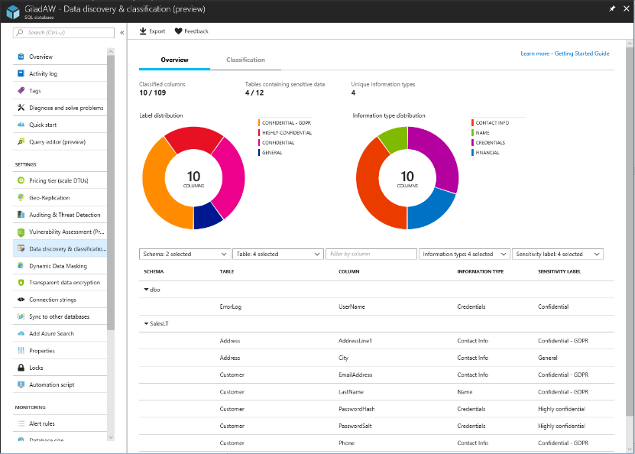
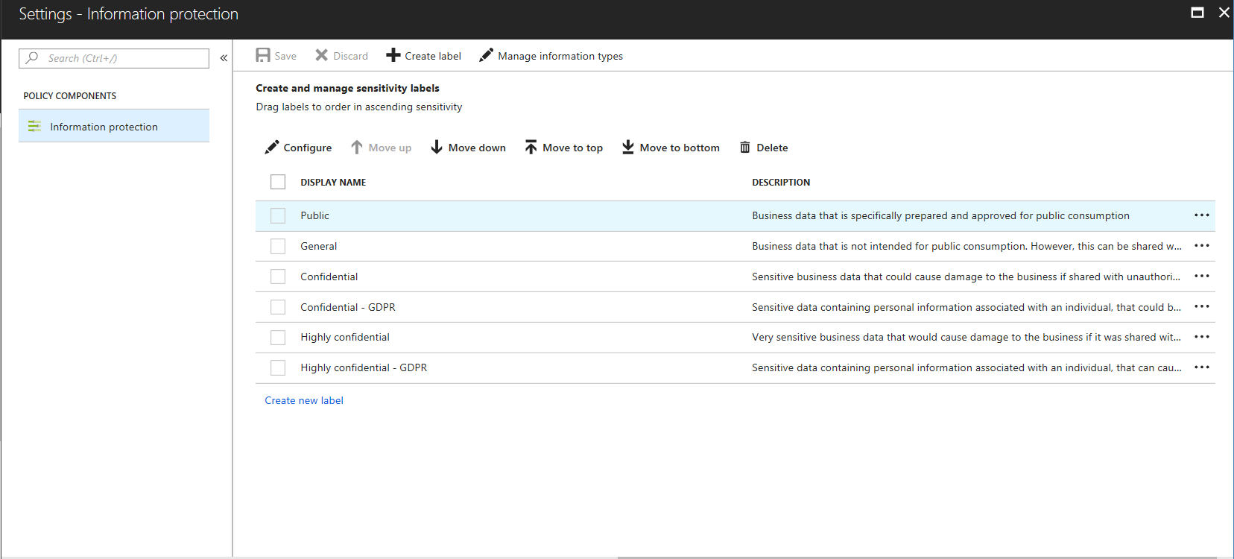
SQL Data discovery & classification PRE
Overview
Automatic discovery of columns with sensitive data
Add persistent sensitive data labels
Audit and detect access to the sensitive data
Manage labels for your entire Azure tenant using Azure Security Center
Discover
Classify
Label

Slide 40
Data warehouse Managed Identities
Overview
Azure SQL Data Warehouse supports managed service identity authentication to Azure Data Lake. This removes the need for storing access credentials in code or in Azure Key vault.
# Generate and assign an Azure AD Identity for DW
Set-AzureRmSqlServer -ResourceGroupName $resourceGroupName -ServerName $serverName -AssignIdentity
# Get ServicePrincipalId assigned to DW
$serverAzureAdIdentity =
(Get-AzureRmADServicePrincipal -SearchString $serverName).Id
Notes:
A common challenge when building cloud applications is how to manage the credentials in your code for authenticating to cloud services. Keeping the credentials secure is an important task. Ideally, the credentials never appear on developer workstations and aren't checked into source control. Azure Key Vault provides a way to securely store credentials, secrets, and other keys, but your code has to authenticate to Key Vault to retrieve them.
The managed identities for Azure resources feature in Azure Active Directory (Azure AD) solves this problem. The feature provides Azure services with an automatically managed identity in Azure AD. You can use the identity to authenticate to any service that supports Azure AD authentication, including Key Vault, without any credentials in your code.
The managed identities for Azure resources feature is free with Azure AD for Azure subscriptions. There's no additional cost.
Note
Managed identities for Azure resources is the new name for the service formerly known as Managed Service Identity (MSI).
Terminology
The following terms are used throughout the managed identities for Azure resources documentation set:
Client ID - a unique identifier generated by Azure AD that is tied to an application and service principal during its initial provisioning.
Principal ID - the object ID of the service principal object for your managed identity that is used to grant role-based access to an Azure resource.
Azure Instance Metadata Service (IMDS) - a REST endpoint accessible to all IaaS VMs created via the Azure Resource Manager. The endpoint is available at a well-known non-routable IP address (169.254.169.254) that can be accessed only from within the VM.
How does the managed identities for Azure resources work?
There are two types of managed identities:
A system-assigned managed identity is enabled directly on an Azure service instance. When the identity is enabled, Azure creates an identity for the instance in the Azure AD tenant that's trusted by the subscription of the instance. After the identity is created, the credentials are provisioned onto the instance. The lifecycle of a system-assigned identity is directly tied to the Azure service instance that it's enabled on. If the instance is deleted, Azure automatically cleans up the credentials and the identity in Azure AD.
A user-assigned managed identity is created as a standalone Azure resource. Through a create process, Azure creates an identity in the Azure AD tenant that's trusted by the subscription in use. After the identity is created, the identity can be assigned to one or more Azure service instances. The lifecycle of a user-assigned identity is managed separately from the lifecycle of the Azure service instances to which it's assigned.
Source: https://docs.microsoft.com/en-us/azure/active-directory/managed-identities-azure-resources/overview

Slide 41
WORKLOAD management lifecycle
Overview
Workload management (isolation, classification, and importance) can be used dynamically in response to pressure on the data warehouse. Configure defaults first, then monitor the pressure on the data warehouse system, and adjust configurations as necessary.
Monitor
Analyze
Configure
Notes:
Talking Points:
Use the ALTER DATABASE statement to enable the query store.
ALTER DATABASE Databasename SET QUERY_STORE = ON;
Query Store catalog views:
sys.database_query_store_options (Transact-SQL)
sys.query_context_settings (Transact-SQL)
sys.query_store_plan (Transact-SQL)
sys.query_store_query (Transact-SQL)
sys.query_store_query_text (Transact-SQL)
sys.query_store_runtime_stats (Transact-SQL)
sys.query_store_runtime_stats_interval (Transact-SQL)
Query Store stored procedures:
sp_query_store_flush_db (Transact-SQL)
sp_query_store_force_plan (Transact-SQL)
sp_query_store_remove_plan (Transct-SQL)
sp_query_store_remove_query (Transact-SQL)
sp_query_store_reset_exec_stats (Transact-SQL)
sp_query_store_unforce_plan (Transact-SQL)

Slide 42
Approximate execution
HyperLogLog Accuracy
Will return a result with a 2% accuracy of true cardinality <CONFIDENCE>
e.g. COUNT (DISTINCT) returns 1,000,000, HyperLogLog will return a value in the range of 999,736 to 1,016,234.
APPROX_COUNT_DISTINCT
Returns the approximate number of unique non-null values in a group
-- Syntax
APPROX_COUNT_DISTINCT ( expression )
-- The approximate number of different order keys by order status from the orders table.
SELECT O_OrderStatus, APPROX_COUNT_DISTINCT(O_OrderKey) AS Approx_Distinct_OrderKey
FROM dbo.Orders
GROUP BY O_OrderStatus
ORDER BY O_OrderStatus;

Slide 43
GROUP BY OPTIONS PRE
GROUP BY with ROLLUP
Creates a group for each combination of column expressions
Rolls up the results into subtotals and grand totals.
GROUPING SETS
Combine multiple GROUP BY clauses into one GROUP BY CLAUSE
Equivalent of UNION ALL of specified groups
-- GROUP BY ROLLUP Example --
SELECT Country,
Region,
SUM(Sales) AS TotalSales
FROM Sales
GROUP BY ROLLUP (Country, Region);
-- GROUP BY SETS Example --
SELECT Country,
SUM(Sales) AS TotalSales
FROM Sales
GROUP BY GROUPING SETS ( Country, () );

Slide 44
Result-set caching
Performance Optimizations > Result-set Caching
Public Preview H2 CY19
Overview
Cache the results of a query in DW storage. This enables interactive response times for repetitive queries against tables with infrequent data changes.
The result-set cache persists even if a data warehouse is paused and resumed later.
Query cache is invalidated and refreshed when underlying table data or query code changes.
Result cache is evicted regularly based on a time-aware least recently used algorithm (TLRU).
-- Turn on/off result-set caching for a database
-- Must be run on the MASTER database
ALTER DATABASE {database_name}
SET RESULT_SET_CACHING { ON | OFF }
-- Turn on/off result-set caching for a client session
-- Run on target data warehouse
SET RESULT_SET_CACHING {ON | OFF}
-- Check result-set caching setting for a database
-- Run on target data warehouse
SELECT is_result_set_caching_on
FROM sys.databases
WHERE name = {database_name}
-- Return all query requests with cache hits
-- Run on target data warehouse
SELECT *
FROM sys.dm_pdw_request_steps
WHERE command like '%DWResultCacheDb%'
AND step_index = 0
Notes:
Result-set caching
The maximum size of the result-set cache is 1TB
Query results are persisted for a maximum of 48 hours but can be evicted earlier to save space based on the least recently used result
Disabled on DW by default unless turned on at a session level or the entire database level
Additional storage costs are incurred by caching query result sets
Check the is_result_set_caching column in the sys.databases DMV to show the result-set caching setting for a database
Users can tell if a query was executed with a result cache hit or miss by querying sys.pdw_request_steps for commands where value is like ‘%DWResultCacheDb%’

Slide 45


Result-set caching flow
Performance Optimizations > Result-set Caching
Public Preview H2 CY19
01010100010100101010
01010100010100101010
1
Client sends query to DW
2
Query is processed using DW compute nodes which pull data from remote storage, process query and output back to client app
3
Query results are cached in remote storage so subsequent requests can be served immediately
01010100010100101010
4
Subsequent executions for the same query bypass compute nodes and can be fetched instantly from persistent cache in remote storage
5
Remote storage cache is evicted regularly based on time, cache usage, and any modifications to underlying table data.
6
Cache will need to be regenerated if query results have been evicted from cache
Notes:
Result-set caching
The maximum size of the result-set cache is 1TB
Query results are persisted for a maximum of 48 hours but can be evicted earlier to save space based on the least recently used result
Disabled on DW by default unless turned on at a session level or the entire database level
Additional storage costs are incurred by caching query result sets
Check the is_result_set_caching column in the sys.databases DMV to show the result-set caching setting for a database
Users can tell if a query was executed with a result cache hit or miss by querying sys.pdw_request_steps for commands where value is like ‘%DWResultCacheDb%’

Slide 46
Indexed (materialized) views
Performance Optimizations > Indexed (materialized) views
Public Preview H2 CY19
-- Create indexed view
CREATE INDEXED VIEW Sales.vw_Orders
WITH
(
DISTRIBUTION = ROUND_ROBIN |
HASH(ProductID)
)
AS
SELECT SUM(UnitPrice*OrderQty) AS Revenue, OrderDate,
ProductID,
COUNT_BIG(*) AS OrderCount
FROM Sales.SalesOrderDetail
GROUP BY OrderDate, ProductID;
GO
-- Disable index view and put it in suspended mode
ALTER INDEX ALL ON Sales.vw_Orders DISABLE;
-- Re-enable index view by rebuilding it
ALTER INDEX ALL ON Sales.vw_Orders REBUILD;
Overview
Indexed views cache the schema and data for a view in DW remote storage. They are useful for improving the performance of ‘SELECT’ statement queries that include aggregations
Indexed views are automatically updated when data in underlying tables are changed. This is a synchronous operation that occurs as soon as the data is changed.
The auto caching functionality allows SQL DW Query Optimizer to consider using indexed view even if the view is not referenced in the query.
Supported aggregations: MAX, MIN, AVG, COUNT, COUNT_BIG, SUM, VAR, STDEV
Notes:
Current Limitations:
If MIN/MAX aggregates are used in the SELECT list, the indexed view will automatically be disabled when UPDATE and DELETE occur in the referenced base tables. Run ALTER INDEX with REBUILD to re-enable the indexed view
Only INNER JOIN is supported
Only HASH and ROUND_ROBIN distributions are supported
Only CLUSTERED COLUMNSTORE INDEX is supported
ALTER VIEW is not supported

Slide 47
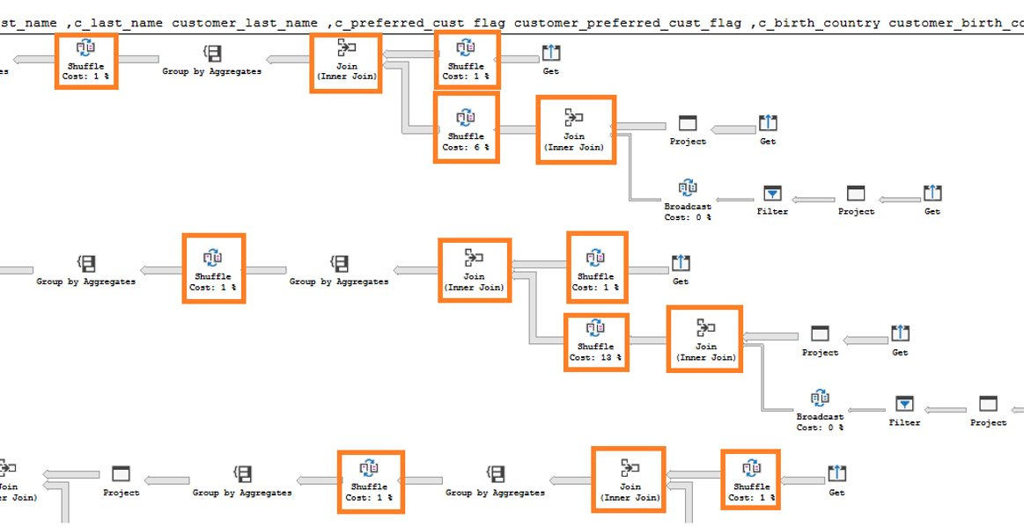
Indexed (materialized) views - example
Performance Optimizations > Indexed (materialized) views > Example
Public Preview H2 CY19
In this example, a query to get the year total sales per customer is shown to have a lot of data shuffles and joins that contribute to slow performance:
Execution time: 103 seconds Lots of data shuffles and joins needed to complete query
No relevant indexed views created on the data warehouse
-- Get year total sales per customer
(WITH year_total AS
SELECT customer_id,​
first_name,​
last_name,
birth_country, login,
email_address​,
d_year,
SUM(ISNULL(list_price – wholesale_cost – discount_amt + sales_price, 0)/2)year_total​
FROM customer cust
JOIN catalog_sales sales ON cust.sk = sales.sk
JOIN date_dim ON sales.sold_date = date_dim.date
GROUP BY customer_id​, first_name​, last_name​,birth_country​, login​,email_address​ ,d_year​
)
SELECT TOP 100 …
FROM year_total …
WHERE …
ORDER BY …

Slide 48
Indexed (materialized) views - example
Performance Optimizations > Indexed (materialized) views > Example
Public Preview H2 CY19
Now, we add an indexed view to the data warehouse to increase the performance of the previous query. This view can be leveraged by the query even though it is not directly referenced.
Original query – get year total sales per customer
Create indexed view with hash distribution on customer_id column
-- Get year total sales per customer
(WITH year_total AS
SELECT customer_id,​
first_name,​
last_name,
birth_country, login,
email_address​,
d_year,
SUM(ISNULL(list_price – wholesale_cost – discount_amt + sales_price, 0)/2)year_total​
FROM customer cust
JOIN catalog_sales sales ON cust.sk = sales.sk
JOIN date_dim ON sales.sold_date = date_dim.date
GROUP BY customer_id​, first_name​, last_name​,birth_country​, login​,email_address​ ,d_year​
)
SELECT TOP 100 …
FROM year_total …
WHERE …
ORDER BY …
-- Create indexed view for query
CREATE INDEXED VIEW nbViewCS WITH (DISTRIBUTION=HASH(customer_id)) AS
SELECT customer_id,​
first_name,​
last_name,
birth_country, login,
email_address​,
d_year,
SUM(ISNULL(list_price – wholesale_cost – discount_amt +
sales_price, 0)/2) AS year_total​
FROM customer cust
JOIN catalog_sales sales ON cust.sk = sales.sk
JOIN date_dim ON sales.sold_date = date_dim.date
GROUP BY customer_id​, first_name​,
last_name​,birth_country​,
login​, email_address​, d_year​

Slide 49
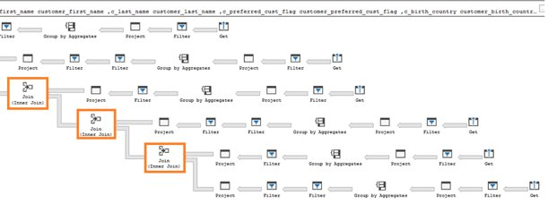
Indexed (materialized) views - example
Performance Optimizations > Indexed (materialized) views > Example
Public Preview H2 CY19
The SQL Data Warehouse query optimizer automatically leverages the indexed view to speed up the same query. Notice that the query does not need to reference the view directly
Execution time: 6 seconds Optimizer leverages materialized view to reduce data shuffles and joins needed
Original query – no changes have been made to query
-- Get year total sales per customer
(WITH year_total AS
SELECT customer_id,​
first_name,​
last_name,
birth_country, login,
email_address​,
d_year,
SUM(ISNULL(list_price – wholesale_cost – discount_amt + sales_price, 0)/2)year_total​
FROM customer cust
JOIN catalog_sales sales ON cust.sk = sales.sk
JOIN date_dim ON sales.sold_date = date_dim.date
GROUP BY customer_id​, first_name​, last_name​,birth_country​, login​,email_address​ ,d_year​
)
SELECT TOP 100 …
FROM year_total …
WHERE …
ORDER BY …

Slide 50
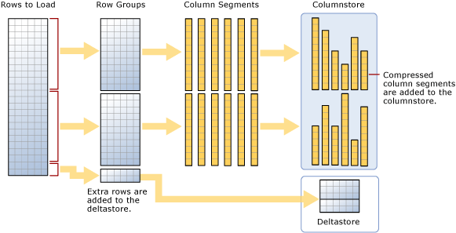
Ordered Columnstore Segments
Performance Optimizations > Clustered Columnstore Index > Ordered Columnstore Segments
Private Preview H2 2019
-- Create Table with Ordered Columnstore Index
CREATE TABLE sortedOrderTable
(
OrderId INT NOT NULL,
Date DATE NOT NULL,
Name VARCHAR(2),
Country VARCHAR(2)
)
WITH
(
CLUSTERED COLUMNSTORE INDEX ORDER (OrderId)
)
-- Create Clustered Columnstore Index on existing table
CREATE CLUSTERED COLUMNSTORE INDEX cciOrderId
ON dbo.OrderTable ORDER (OrderId)
-- Insert data into table with ordered columnstore index
INSERT INTO sortedOrderTable
VALUES (1, '01-01-2019','Dave’, 'UK')
Overview
Queries against tables with ordered columnstore segments can take advantage of improved segment elimination to drastically reduce the time needed to service a query.
Columnstore Segments are automatically updated as data is inserted, updated, or deleted in data warehouse tables.

Slide 51
Snapshot isolation
Analytics > Snapshot Isolation
Private Preview Mar’2019
Overview
Specifies that statements cannot read data that has been modified but not committed by other transactions.
This prevents dirty reads.
Isolation level
READ_COMMITTED_SNAPSHOT
OFF (Default) – Uses shared locks to prevent other transactions from modifying rows while running a read operation
ON – Uses row versioning to present each statement with a transactionally consistent snapshot of the data as it existed at the start of the statement. Locks are not used to protect the data from updates.
ALTER DATABASE MyDatabase
SET READ_COMMITTED_SNAPSHOT ON
Notes:
READ COMMITTED Specifies that statements cannot read data that has been modified but not committed by other transactions. This prevents dirty reads. Data can be changed by other transactions between individual statements within the current transaction, resulting in nonrepeatable reads or phantom data. This option is the SQL Server default.
The behavior of READ COMMITTED depends on the setting of the READ_COMMITTED_SNAPSHOT database option:
If READ_COMMITTED_SNAPSHOT is set to OFF (the default on SQL Server), the Database Engine uses shared locks to prevent other transactions from modifying rows while the current transaction is running a read operation. The shared locks also block the statement from reading rows modified by other transactions until the other transaction is completed. The shared lock type determines when it will be released. Row locks are released before the next row is processed. Page locks are released when the next page is read, and table locks are released when the statement finishes.
If READ_COMMITTED_SNAPSHOT is set to ON (the default on SQL Azure Database), the Database Engine uses row versioning to present each statement with a transactionally consistent snapshot of the data as it existed at the start of the statement. Locks are not used to protect the data from updates by other transactions.
Source: https://docs.microsoft.com/en-us/sql/t-sql/statements/set-transaction-isolation-level-transact-sql?view=sql-server-2017

Slide 52
JSON data support – insert JSON data
Analytics > JSON data support
Public Preview H2 CY19
Overview
The JSON format enables representation of complex or hierarchical data structures in tables.
JSON data is stored using standard NVARCHAR table columns.
-- Create Table with column for JSON string
CREATE TABLE CustomerOrders
(
CustomerId BIGINT NOT NULL,
Country NVARCHAR(150) NOT NULL,
OrderDetails NVARCHAR(3000) NOT NULL –- NVARCHAR column for JSON
) WITH (DISTRIBUTION = ROUND_ROBIN)
-- Populate table with semi-structured data
INSERT INTO CustomerOrders
VALUES
( 101, -- CustomerId
'Bahrain', -- Country
N'[{ StoreId": "AW73565",
"Order": { "Number":"SO43659",
"Date":"2011-05-31T00:00:00"
},
"Item": { "Price":2024.40, "Quantity":1 }
}]’ -- OrderDetails
)

Slide 53
JSON data support – read JSON data
Analytics > JSON data support
Public Preview H2 CY19
Overview
Read JSON data stored in a string column with the following:
ISJSON – verify if text is valid JSON
JSON_VALUE – extract a scalar value from a JSON string
JSON_QUERY – extract a JSON object or array from a JSON string
-- Return all rows with valid JSON data
SELECT CustomerId, OrderDetails
FROM CustomerOrders
WHERE ISJSON(OrderDetails) > 0;
CustomerId | OrderDetails
101 | N'[{ StoreId": "AW73565", "Order": { "Number":"SO43659", "Date":"2011-05-31T00:00:00“ }, "Item": { "Price":2024.40, "Quantity":1 }}]'
-- Extract values from JSON string
SELECT CustomerId,
Country,
JSON_VALUE(OrderDetails,'$.StoreId') AS StoreId,
JSON_QUERY(OrderDetails,'$.Item') AS ItemDetails
FROM CustomerOrders;
CustomerId | Country | StoreId | ItemDetails
101 | Bahrain | AW73565 | { "Price":2024.40, "Quantity":1 }

Slide 54
JSON data support – modify and operate on JSON data
Analytics > JSON data support
Public Preview H2 CY19
Overview
Use standard table columns and values from JSON text in the same analytical query.
Modify JSON data with the following:
JSON_MODIFY – modifies a value in a JSON string
OPENJSON – convert JSON collection to a set of rows and columns
-- Modify Item Quantity value
UPDATE CustomerOrders SET OrderDetails =
JSON_MODIFY(OrderDetails, '$.OrderDetails.Item.Quantity',2)
OrderDetails
N'[{ StoreId": "AW73565", "Order": { "Number":"SO43659", "Date":"2011-05-31T00:00:00“ }, "Item": { "Price":2024.40, "Quantity": 2}}]'
-- Convert JSON collection to rows and columns
SELECT CustomerId,
StoreId,
OrderDetails.OrderDate,
OrderDetails.OrderPrice
FROM CustomerOrders
CROSS APPLY OPENJSON (CustomerOrders.OrderDetails)
WITH ( StoreId VARCHAR(50) '$.StoreId',
OrderNumber VARCHAR(100) '$.Order.Date',
OrderDate DATETIME '$.Order.Date',
OrderPrice DECIMAL ‘$.Item.Price',
OrderQuantity INT '$.Item.Quantity'
) AS OrderDetails
CustomerId | StoreId | OrderDate | OrderPrice
101 | AW73565 | 2011-05-31T00:00:00 | 2024.40

Slide 55
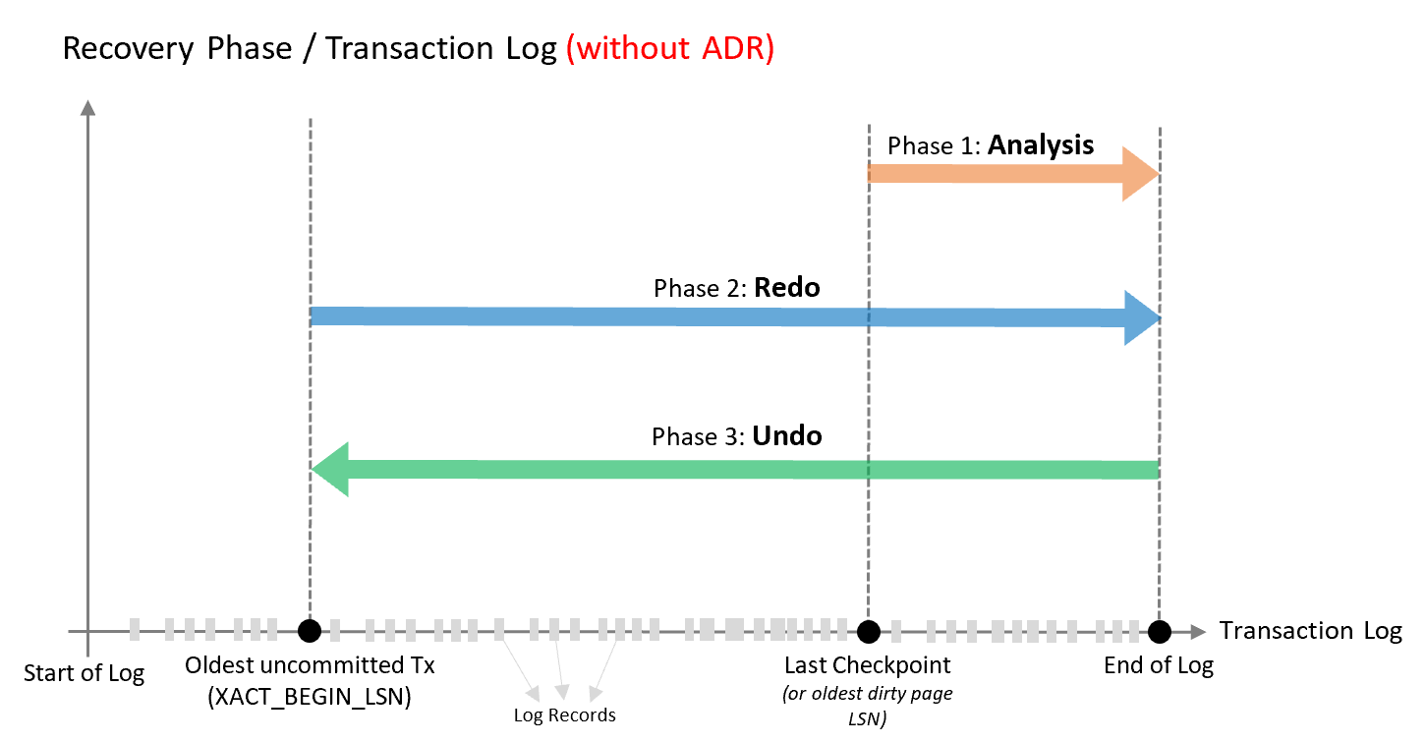
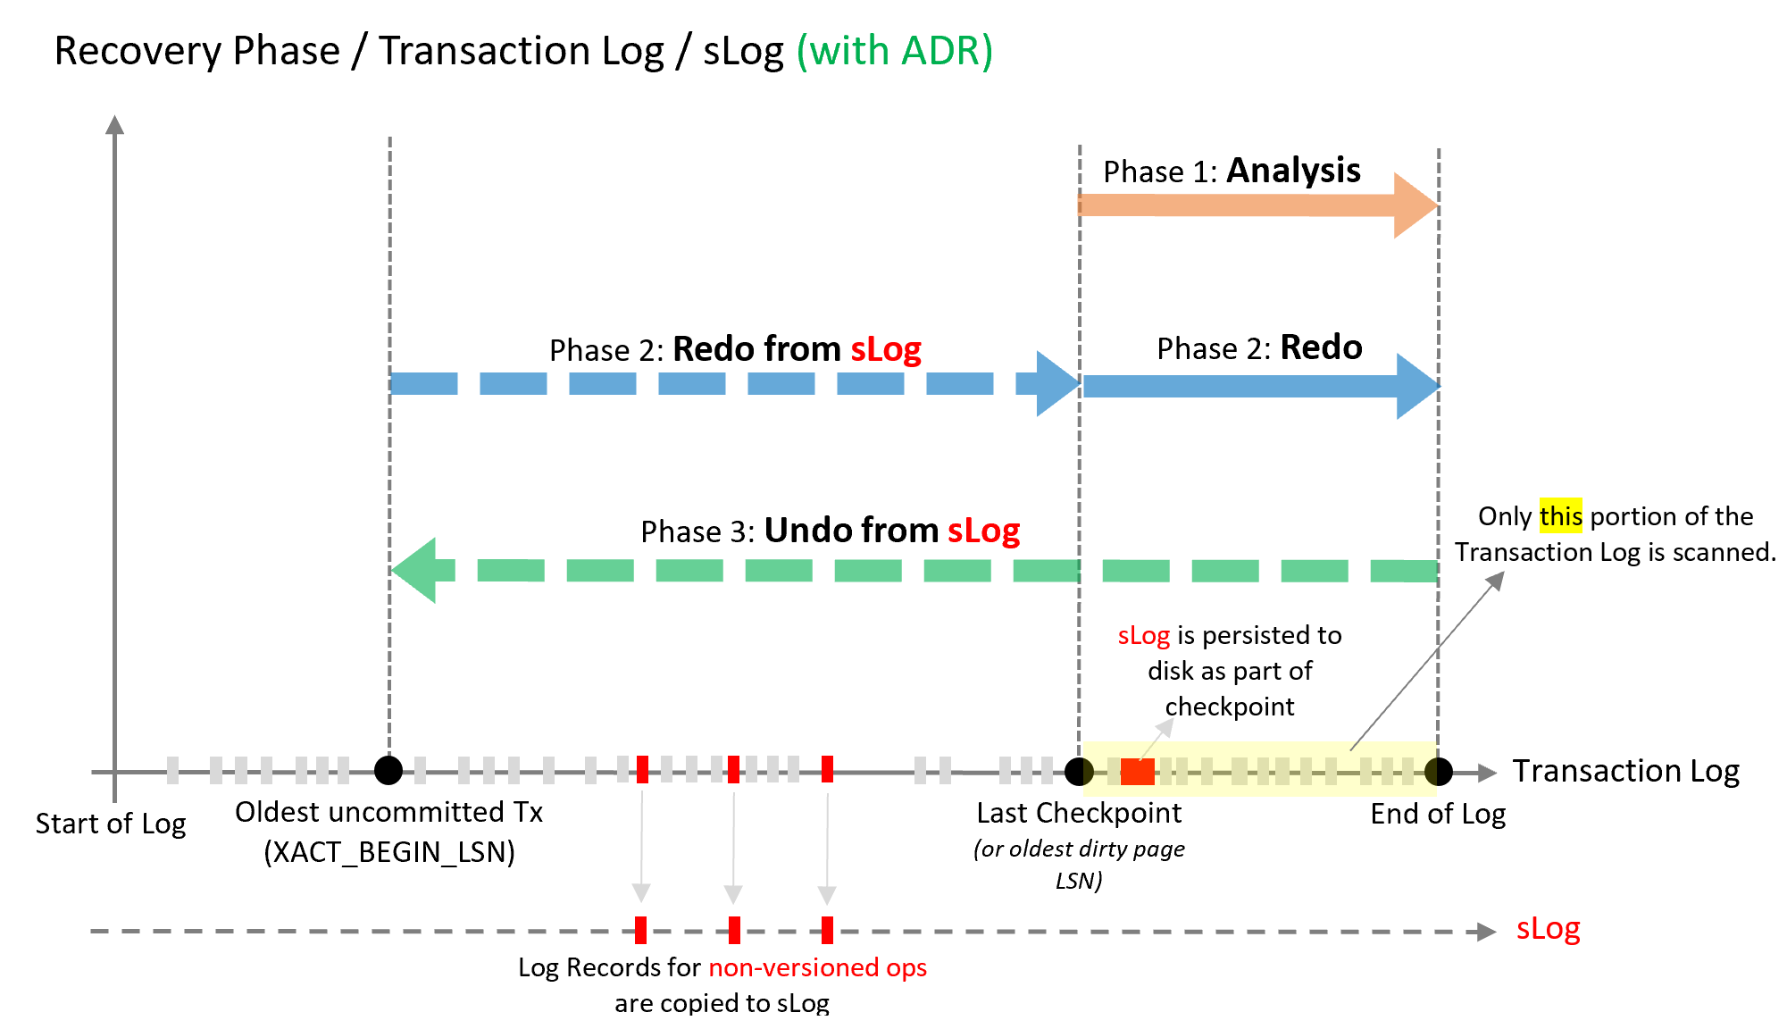
Accelerated database recovery
Overview
New SQL database engine feature
Redesigns the engine recovery process
Speeds up the 3 recovery phases
Benefits
Fast and consistent database recovery
Instantaneous transaction rollback
Regardless of number or age of transactions
Fast pause and resume operations
Notes:
https://docs.microsoft.com/en-us/azure/sql-database/sql-database-accelerated-database-recovery
3 phases of database recovery
Analysis phase
Forward scan of the transaction log from the beginning of the last successful checkpoint (or the oldest page LSN) until the end, to determine the state of each transaction at the time SQL Server stopped
Redo phase
Forward scan of the transaction log from the oldest uncommitted transaction until the end, to bring the database to the state it was at the time of the crash by redoing all operations
Undo phase
For each transaction that was active as of the time of the crash, traverses the log backwards, undoing the operations that this transaction performed.
ADR uses the same 3 steps, but uses four key components to help speed up recovery:
Persisted Version Store (PVS)
The persisted version store is a new SQL database engine mechanism for persisting the row versions generated in the database itself instead of the traditional tempdb version store. PVS enables resource isolation as well as improves availability of readable secondaries.
Logical Revert
Logical revert is the asynchronous process responsible for performing row level version based Undo - providing instant transaction rollback and undo for all versioned operations.
sLog
sLog is a secondary in-memory log stream that stores log records for non-versioned operations (such as metadata cache invalidation, lock acquisitions, and so on).
Cleaner
The cleaner is the asynchronous process that wakes up periodically and cleans page versions that are not needed.

Slide 56
Windowing functions
Analytics > Windowing functions
SELECT
ROW_NUMBER() OVER(PARTITION BY PostalCode ORDER BY SalesYTD DESC
) AS "Row Number",
LastName,
SalesYTD,
PostalCode
FROM Sales
WHERE SalesYTD <> 0
ORDER BY PostalCode;
OVER clause
Defines a window or specified set of rows within a query result set
Computes a value for each row in the window
Aggregate functions
COUNT, MAX, AVG, SUM, APPROX_COUNT_DISTINCT, MIN, STDEV, STDEVP, STRING_AGG, VAR, VARP, GROUPING, GROUPING_ID, COUNT_BIG, CHECKSUM_AGG
Analytical functions
LAG, LEAD, FIRST_VALUE, LAST_VALUE, CUME_DIST, PERCENTILE_CONT, PERCENTILE_DISC, PERCENT_RANK
Ranking functions
RANK, NTILE, DENSE_RANK, ROW_NUMBER
ROWS | RANGE
PRECEDING, UNBOUNDING PRECEDING, CURRENT ROW, BETWEEN, FOLLOWING, UNBOUNDED FOLLOWING
Row Number | LastName | SalesYTD | PostalCode
1 | Mitchell | 4251368.5497 | 98027
2 | Blythe | 3763178.1787 | 98027
3 | Carson | 3189418.3662 | 98027
4 | Reiter | 2315185.611 | 98027
5 | Vargas | 1453719.4653 | 98027
6 | Ansman-Wolfe | 1352577.1325 | 98027
1 | Pak | 4116870.2277 | 98055
2 | Varkey Chudukaktil | 3121616.3202 | 98055
3 | Saraiva | 2604540.7172 | 98055
4 | Ito | 2458535.6169 | 98055
5 | Valdez | 1827066.7118 | 98055
6 | Mensa-Annan | 1576562.1966 | 98055
7 | Campbell | 1573012.9383 | 98055
8 | Tsoflias | 1421810.9242 | 98055

Slide 57
Approximate execution
Analytics > Approximate execution
HyperLogLog accuracy
Will return a result with a 2% accuracy of true cardinality on average.
e.g. COUNT (DISTINCT) returns 1,000,000, HyperLogLog will return a value in the range of 999,736 to 1,016,234.
APPROX_COUNT_DISTINCT
Returns the approximate number of unique non-null values in a group.
Use Case: Approximating web usage trend behavior
-- Syntax
APPROX_COUNT_DISTINCT ( expression )
-- The approximate number of different order keys by order status from the orders table.
SELECT O_OrderStatus, APPROX_COUNT_DISTINCT(O_OrderKey) AS Approx_Distinct_OrderKey
FROM dbo.Orders
GROUP BY O_OrderStatus
ORDER BY O_OrderStatus;

Slide 58
Group by options
Analytics > Group by options
Public Preview Apr’2019
Group by with rollup
Creates a group for each combination of column expressions.
Rolls up the results into subtotals and grand totals.
Grouping sets
Combine multiple GROUP BY clauses into one GROUP BY CLAUSE.
Equivalent of UNION ALL of specified groups.
-- GROUP BY ROLLUP Example --
SELECT Country,
Region,
SUM(Sales) AS TotalSales
FROM Sales
GROUP BY ROLLUP (Country, Region);
-- Results --
-- GROUP BY SETS Example --
SELECT Country,
SUM(Sales) AS TotalSales
FROM Sales
GROUP BY GROUPING SETS ( Country, () );
Country | Region | TotalSales
Canada | Alberta | 100
Canada | British Columbia | 500
Canada | NULL | 600
United States | Montana | 100
United States | NULL | 100
NULL | NULL | 700

Slide 59
Databricks – structured streaming
# Prepare streaming source; this could be Kafka, Kinesis, or a simple rate stream.
df = spark.readStream \
.format("rate") \
.option("rowsPerSecond", "100000") \
.option("numPartitions", "16") \
.load()
# Apply some transformations to the data then use
# Structured Streaming API to continuously write the data to a table in SQL DW.
df.writeStream \
.format("com.databricks.spark.sqldw") \
.option("url", <azure-sqldw-jdbc-url>) \
.option("tempDir", "wasbs://<containername>@<storageaccount>.blob.core.windows.net/<directory>") \
.option("forwardSparkAzureStorageCredentials", "true") \
.option("dbTable", <table-name>) \
.option("checkpointLocation", "/tmp_location") \
.start()
Overview
The Databricks SQL DW connector supports batch and structured streaming support for writing real-time data into Azure SQL Data Warehouse.
It uses Polybase and the Databricks structured streaming API to stream data from Kafka, Kinesis sources directly into SQL DW at a user-configurable rate.
Source: https://docs.azuredatabricks.net/spark/latest/data-sources/azure/sql-data-warehouse.html#streaming-support

Slide 60
Since Gen2 GA
05/14/18 Automatic Statistics
06/16/18 User Defined Restore Points
06/21/19 Column-level security
07/25/18 Fast Restore
08/02/18 Recommendations for data skew and table statistics
09/24/18 Streaming support in Azure Databricks
09/24/18 User defined maintenance scheduling
09/24/18 Vulnerability assessment
09/24/18 Intelligent Insights
09/24/18 Flexible Restore Points
11/07/18 RLS
11/12/18 Azure Monitor log support
12/08/18 Azure Virtual Network service endpoints
01/10/19 Azure Data Box Disk
Upcoming Features:
Copy Command
Work Load Management
Notes:
https://azure.microsoft.com/en-us/updates/?product=sql-data-warehouse
Data Box Disk

Slide 61
Q&A

